Slide 1
Product Spectrum Images
By Joel Plascencia

Slide 2
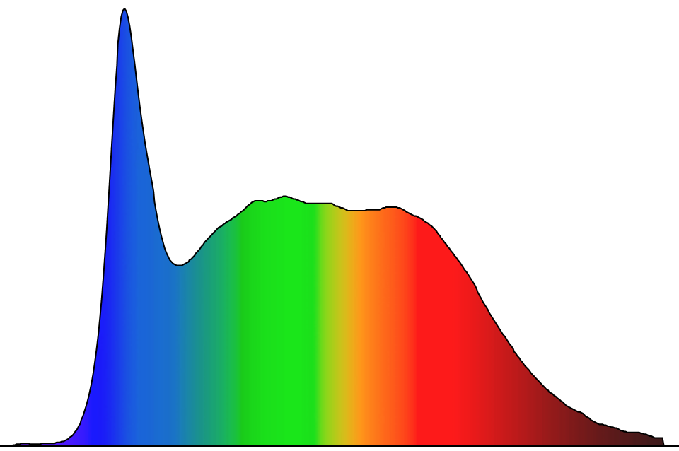
5200K

Slide 3
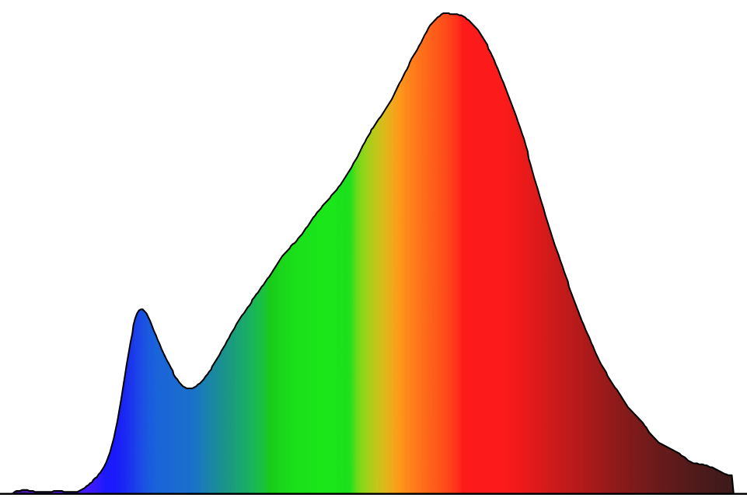
2700K

Slide 4
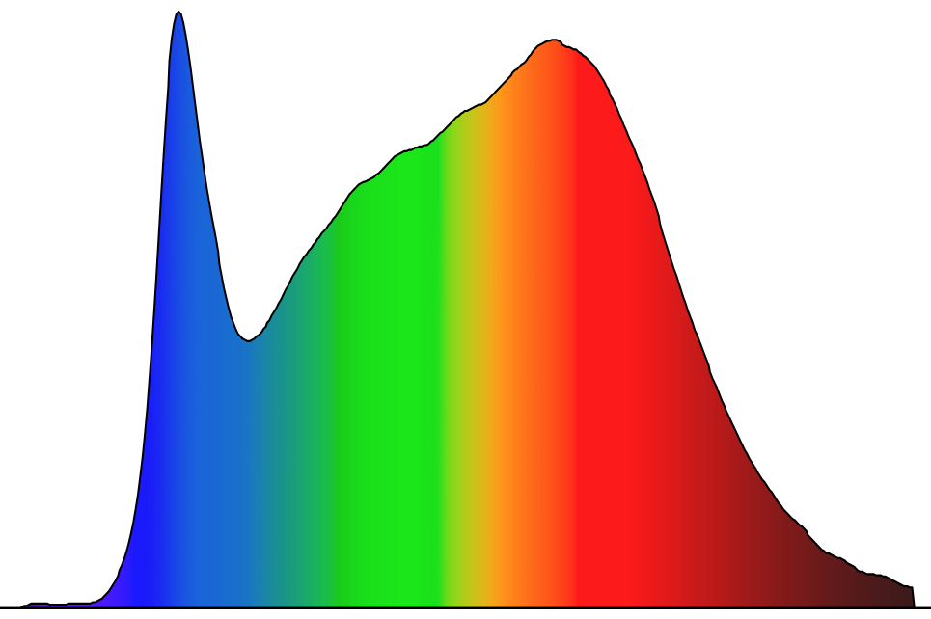
3850K

Slide 5
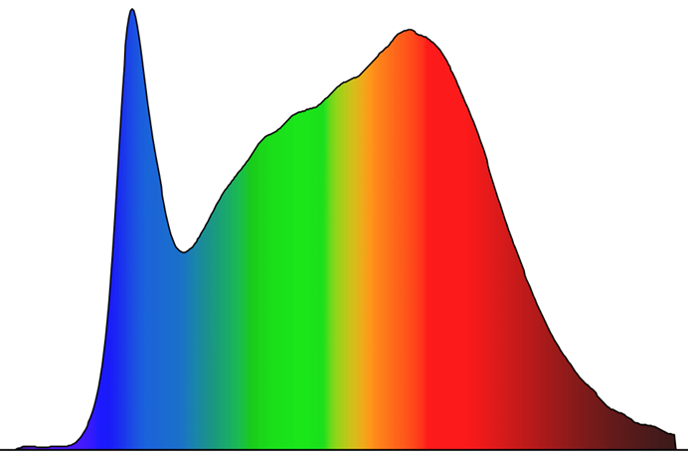
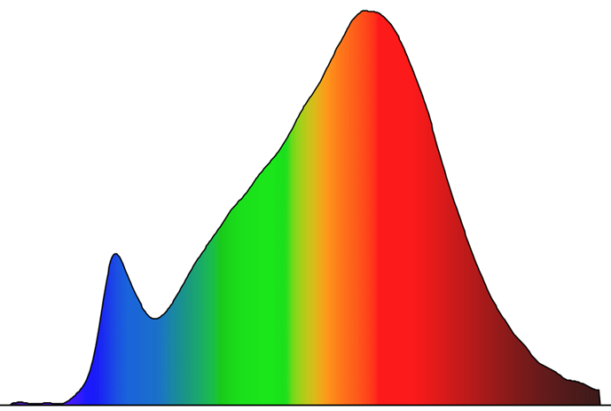
Time Pathway
2PM
10AM
6PM
6AM
10PM

